Slide 1

Loan approval predication based on Income class
Team members:
KURELLA BHAVESH.
Chimmula Akhil Reddy Yelagandula Shashank

Slide 2
About Dataset:
This dataset contains six continuous variables Eight categorical/factor variable which in this dataset each instance talks about a person.
It is a multivariant dataset with consisting of 32,000 rows , 14 variables in that income class is dependent variable
By estimating the income class of new person who comes to bank for loan using model build can predict weather the respective bank can provide loan or not. Source:
[1] “UCI Machine Learning Repository: Adult Data Set,” archive.ics.uci.edu. http://archive.ics.uci.edu/ml/datasets/Adult
‌

Slide 3
Research question:
Can we predict a person's income class based on their demographic and work-related attributes?
Is there a significant difference in the distribution of income classes, hours worked per week, education level, and age distribution among individuals from different native countries?
Can we predict person capital gain based on age, hours of work, years of education using suitable ML technique?

Slide 4
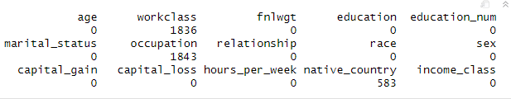
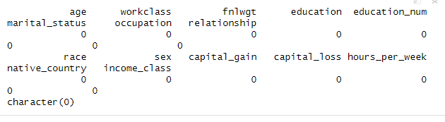
Data Cleaning and Transformation
In this each categorical variable as many different values which is hard to interpret and recognize
Needs some transformation for more better analysis.
And also observed few “?” in the dataset which technical represents “NA” which has been adjusted
To make sure there is no loss of data we are not just omitting the NA rows but I imputed NA values with mode imputation technique.
Before: After:

Slide 5
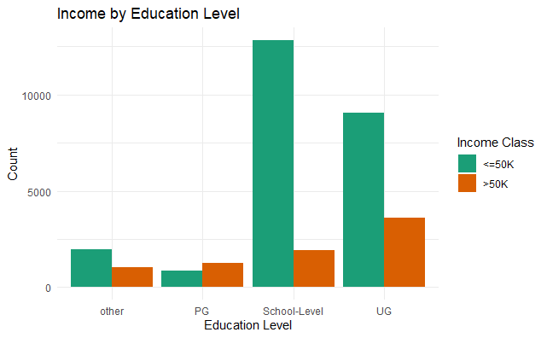
Analysis and Visualization -I
From the visualization we can see Education level plays key role for the income class therefore I am expecting a significant difference between education level and income class so to find that we can perform appropriate statistical significance test

Slide 6
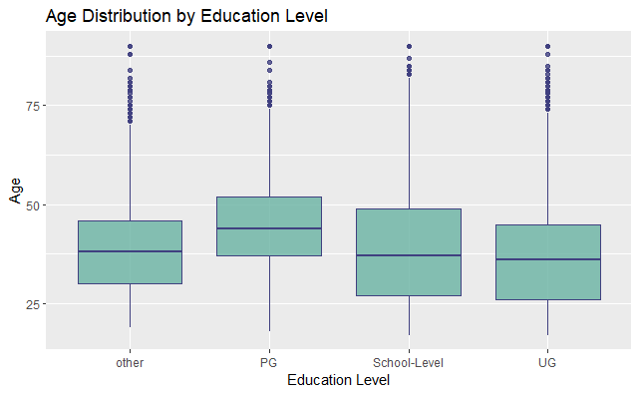
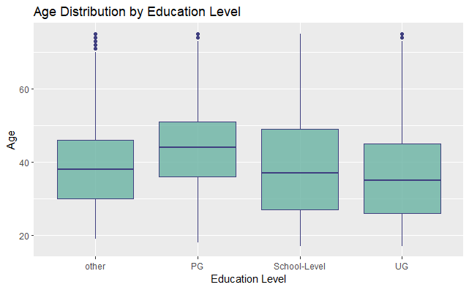
Analysis and Visualization -II
In This visualization we can observe outliers in the dataset which will compromise quality of the data so I have decided to remove data points with age column grater than or equal to 75 Before removing outliers: After removing outliers:

Slide 7
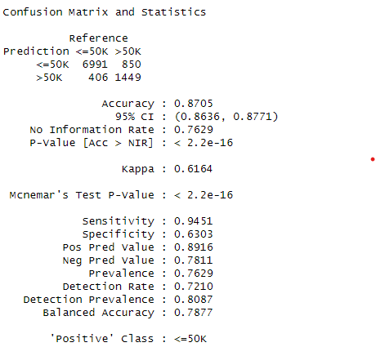
Research questions
Can we predict a person's income class based on their demographic and work-related attributes using Random Forest
Performed Random forest method to classify weather a respective person fall under >=50K category or <50k
The random forest model can be represented as an ensemble of decision trees T_1, T_2, ..., T_m, where m is the number of trees in the forest. Given a new observation x, the random forest model predicts the income class y_hat by aggregating the predictions of all the decision trees in the forest:
y_hat = mode { T_1(x), T_2(x), ..., T_m(x) }

Slide 8
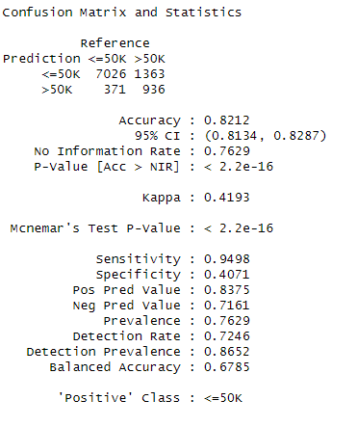
Research questions
Can we predict a person's income class based on their demographic and work-related attributes using logistic regression model using LASSO regularization
p(x) = 1 / (1 + exp(- (b0 + b1x1 + b2x2 + ... + bp*xp))) b0 is intercept,b1…bp are regression coefficients x1=> age,X2=>fnlwgt,x3=>years of education,x4=> capital gain, x5 => capital loss , x6=>hours per week
P(x) > 0.5 then >50k else <=50k
After performing two techniques found Random forest gives better results

Slide 9

Is there a significant difference in the distribution of income classes between different native countries?
Pearson's chi-squared test is a statistical hypothesis test that is used to determine whether there is a significant association between two categorical variables. chi-squared = sum((O-E)^2 / E) The calculated test statistic was 274.26, with 10 degrees of freedom, and a p-value less than 2.2e-16, indicating strong evidence against the null hypothesis of independence between income class and native country. Therefore, it can be concluded that there is a significant association between income class and native country.

Slide 10
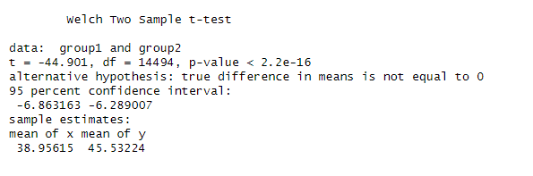
Is there a significant difference in the hours worked per week between different income classes?
A t-test was performed to compare the mean hours worked per week between two groups based on income class. The calculated test statistic was -49.0, with a p-value less than 2.2e-16, indicating strong evidence against the null hypothesis of no difference in mean hours worked per week between the two income classes. t = (x1 - x2) / (s_p * sqrt(1/n1 + 1/n2))
x1=>sample mean of income calss >50k
X2=>sample mean of income class <=50k
S_p=>SD of two groups above
n1 and n2 sample sizes of the two groups
Therefore, it can be concluded that there is a significant difference in mean hours worked per week between the two income classes

Slide 11
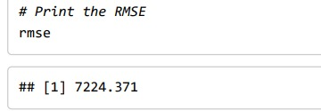
Predicating capital gain based on education num, age, hours per week using multiple linear regression?
y = β0 + β1 * x1 + β2 * x2 + β3 * x3 + ε
where:
y is the predicted capital_gain value
β0 is the intercept term
β1, β2, and β3 are the regression coefficients for the age, education_num, and hours_per_week variables, respectively
x1, x2, and x3 are the values of the age, education_num, and hours_per_week variables, respectively
ε is the error term

Slide 12
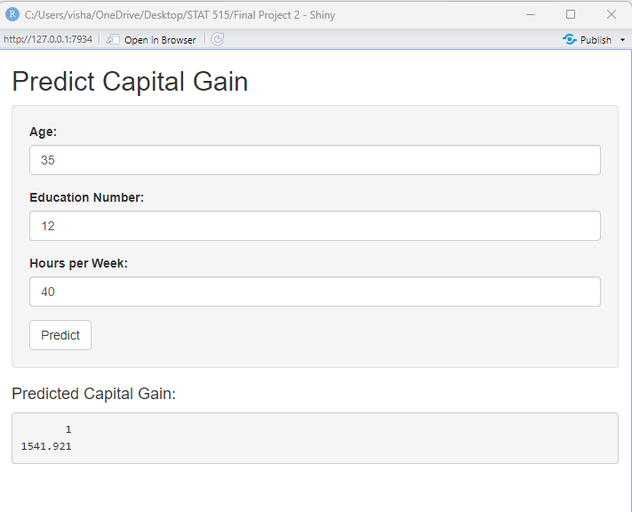
Shiny Application for predicting capital gain
After all the analysis and modelling we want our effort to be utilized to even common people
So to achieve that we made an application using shiny package in R
Use case: A person want to know what will be the his/her capital gain while knowing attributes given which helps

Slide 13
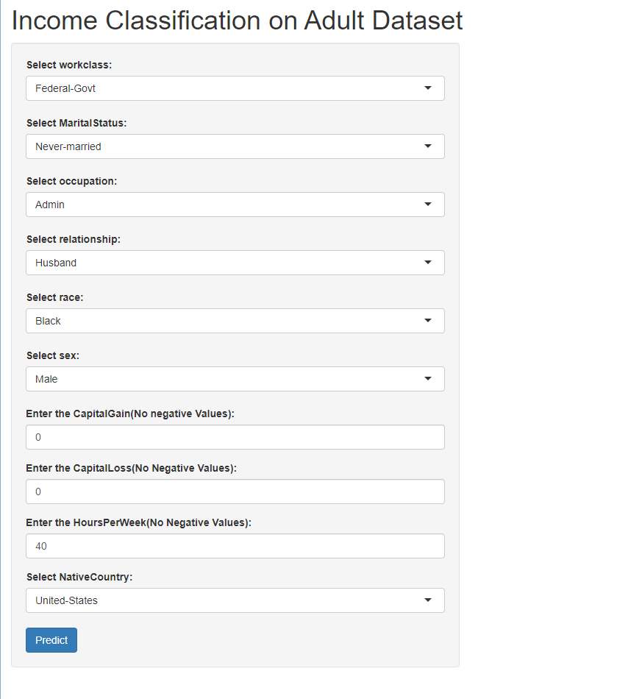
Shiny Application for predicting income class
After all the analysis and modelling we want our effort to be utilized to even common people
So to achieve that we made an application using shiny package in R
Use case: A person came to bank for loan approval where the initial details of loan seeker is collected run the model with the given application details

Slide 14
RESULT:
Information about people and their income is available in the dataset from the UCI Machine Learning Repository. In all, there are 48,842 cases in this dataset.
The dataset's objective is to determine from these features if a person's annual income is larger than $50,000.The preprocessing of the dataset included the imputation of of cases with missing values and the conversion of multiple categorical variables into best possible level of categorical variables.
The dataset was subjected to the application of several machine learning models, such as logistic regression with LASSO regularization, chi-squared tests, t-tests, and linear regression.
With the help of these models, it was possible to forecast an individual's income based on the given features and identify the factors that were most crucial for doing so.

Slide 15
Special Efforts:
Furthermore, a Shiny app 1 was developed to enable users to input their own values for age, education level, and hours worked each week and get an estimation of their predicted capital gain based on the model.
Shiny app 2 was developed to predict weather person income class with respect to variables in the dataset.

Slide 16

Thank you!!

